Slide 1
Capstone Project: the battle of the neighborhoods
Restaurants in Cologne (Germany)

Slide 2
Introduction
There are a huge number of restaurants in Cologne, almost 1600.
Cologne is located in the third place in Germany by the number of restaurants, marked with Michelin stars, because there even six such restaurants. In Cologne and its neighborhood, you can have a meal for any taste and purse: from 'quick, cheap and not spicy at all' to 'long, tasty and expensive'. The purpose of this project will be to help tourists to understand this disarray. We will analyze in which districts and which restaurants are presented.

Slide 3
AGENDA
Description of the data
Foursquare location data will be the main tool for problem solving and its implementation
I will also use the Cologne district/city overview from Wikipedia: https://en.wikipedia.org/wiki/Districts_of_Cologne.
I enabled geopy functions by installing the conda-forge geopy package.
I used the nominatim function to add geospatial data to the data frame, that is the latitude and the longitude seen on the right side of the following table.

Slide 4
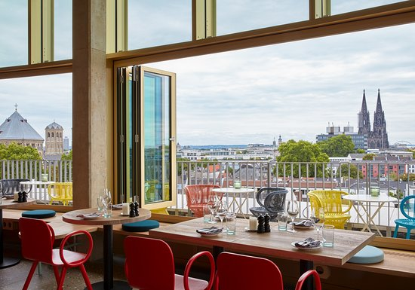
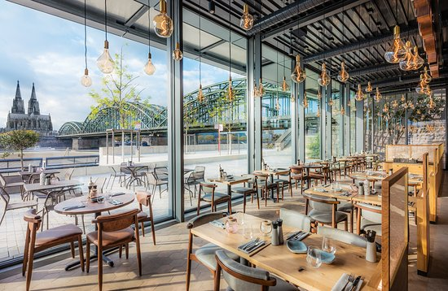
A bit of inspiration
.

Slide 5
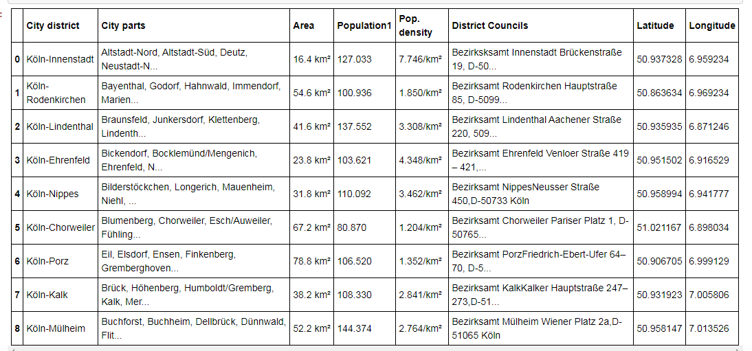
C
ologne
RESTAURANTS
Get a modern PowerPoint Presentation that is beautifully designed. Easy to change colors, photos and Text. You can simply impress your audience and add a unique zing and appeal to your Presentations.

Slide 6
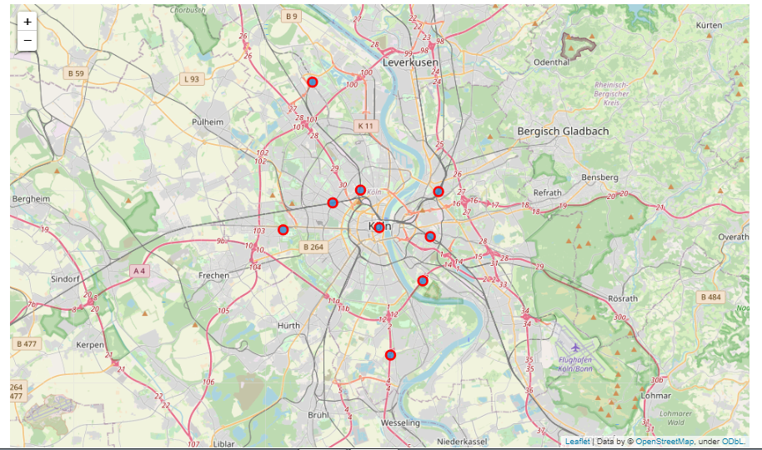
.
Afterwards I used python folium library to visualize geographic details of Cologne and its major districts and I created a map of Cologne with boroughs superimposed on top. I used latitude and longitude values to get the visual as here:

Slide 7
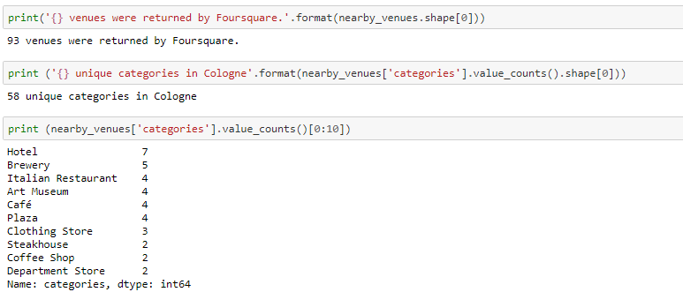
Foursquare API
Using the Foursquare API I got the top 100 venues that are in Cologne within a radius of 500 meters
.

Slide 8
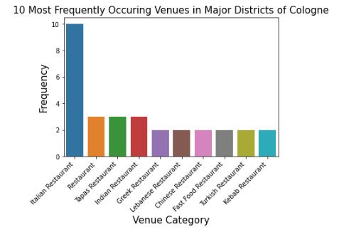
Later on, I concentrated in Restaurant Category only and explore all the districts.
I found out 24 unique venue categories and Italian Restaurant top the charts as we can see in the plot below:

Slide 9
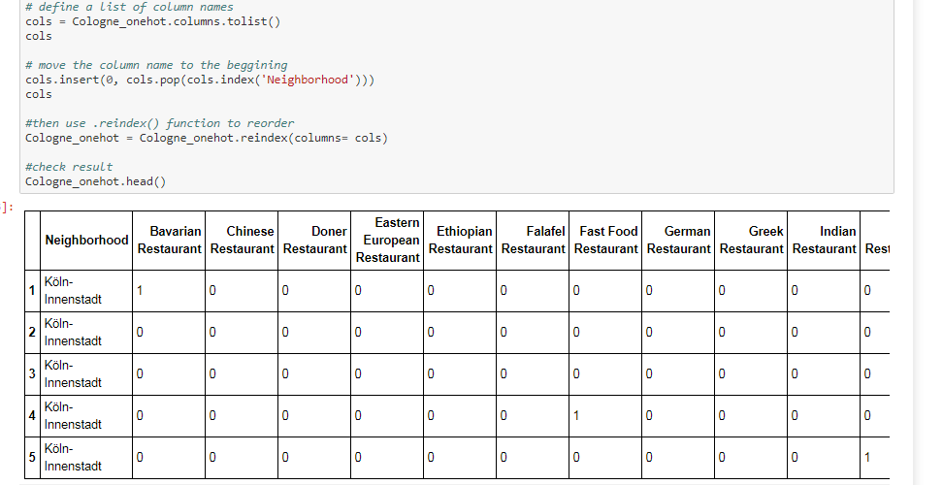
That means that you definitely should try tasty italian pizza while visiting Cologne. But we still want to figure out in which area such food is more common? So we should return to investigating the information somewhat more.
Let us analize the neiborhoods to figure out 5 most popular venues in each.

Slide 10
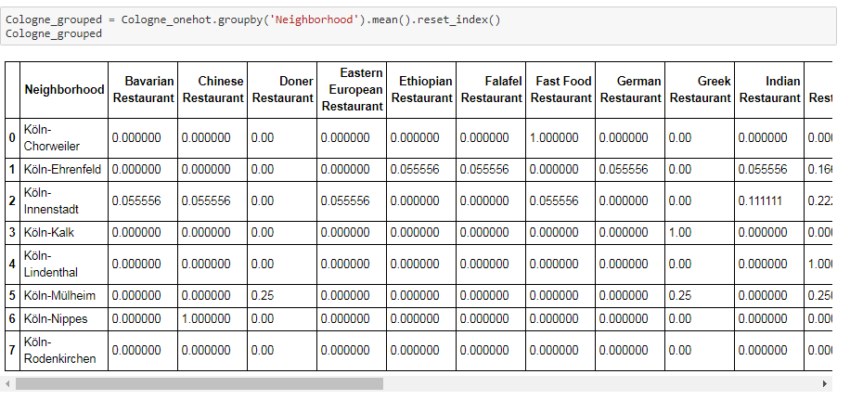
Mean()
Next, let's group rows by neighborhood and by taking the mean of the frequency of occurrence of each category

Slide 11
AWESOME
Results
1
Italian restaurants top the charts of most common venues in the districts.
2
Köln-Innenstadt and Köln-Rodenkirchen has maximum number of restaurants
.
3
Köln-Nippes has the least number of restaurants.

